Slide 1
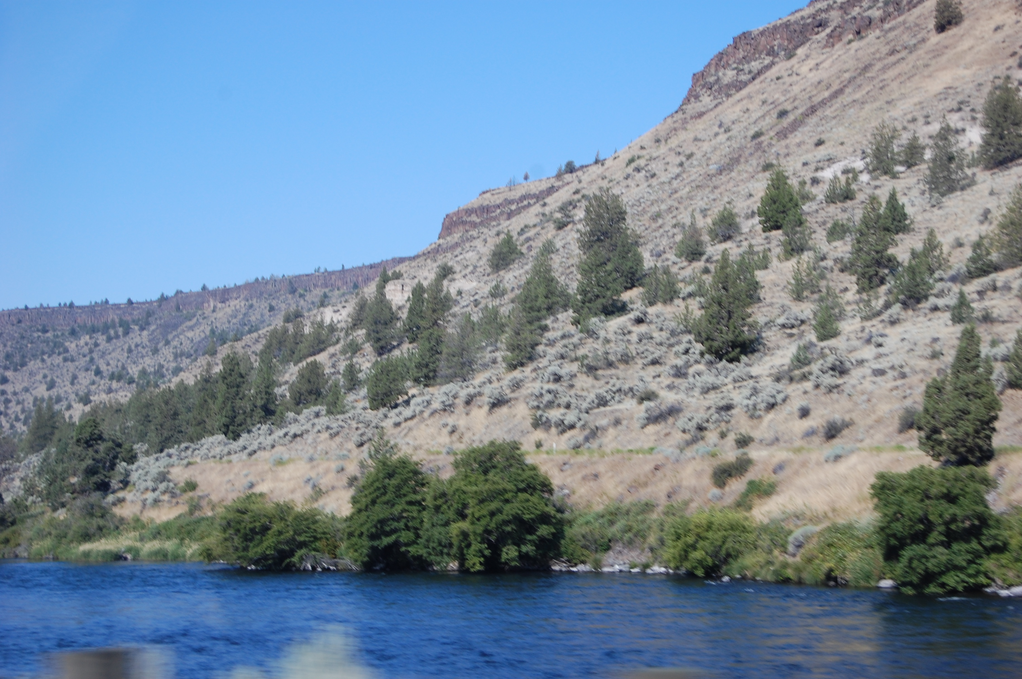
If It Looks Like A Duck…..
How To Identify A Christian

Slide 2
There is an old saying, not very sophisticated for this era, but it makes a lot of sense.
It goes like this:
“Just sittin’ in a hen house don’t make you a hen.”
Hard to argue with that, and the second stanza says:
“Just sittin’ in a church house don’t make you a Christian.”
Some may not like where this is going, but it’s hard to argue with sound reasoning.

Slide 3
Introduction
We know that in the denominational world, most people identify as Christian.
However when we examine such by the scriptures, we find a huge contradiction.
Many who claim to be Christian are not.
Even the surveys find that most people in this country identify as Christians that expect to go to heaven.
This is even a problem in the church.

Slide 4
There is an old timey song with these lyrics:
“Everybody talking about heaven ain’t going there.
There is a lot of truth in such lyrics.
Most people just laugh it off and pay little to no attention to such thinking.
But our Lord said this:
“Not everyone who says to Me, Lord, Lord, shall enter the kingdom of heaven, but he who does the will of my Father in heaven” (Matthew 7:21).

Slide 5
Common Sense Is Needed
Let’s see how this works.
How can you tell if something is a duck?
There is a saying that goes like this: If it looks like a duck, walks like a duck, and sounds like a duck……it must be a duck.
OK, sounds right to me, how about you?
Of course in order to make that judgment, one would actually need to know what a duck looks walks and sounds like to make that determination.

Slide 6
Let’s try one more to make our point.
“If it looks like a cow, and it walks like a cow, and it moos like a cow……..it must be a cow.
Well it could be a bull, but that is semantics.
We could compare all the animal kingdom with the same criteria, and still end up with common sense telling us what it is.
But let’s just throw common sense out the window for a moment.

Slide 7
How do we identify a Christian.
It takes more than talk and empty claims to be a Christian.
The Bible is the only criteria to establish what a Christian is.
Anything other than the bible leaves a lot lacking, because we know the world of denominationalism has claimed everyone a Christian.
Let’s see what the Bible instructs us to do and be so that our claim of being a Christian is not in vain.

Slide 8
A Christian Will Be:
The salt of the earth and a light to the world (Matthew 5:14-16).
Can one claim to be a Christian without this quality?
A new creature, as the old things have passed away (2 Corinthians 5:17).
Can one continue in a life of sin and claim they are a new creature?

Slide 9
A Christian Will Be:
Living in the world, but not be a worldly person (1 Corinthians 5:1-10).
Can one who lives like the world be trusted when they call themselves a Christian?
Can one continue in immoral behavior like most of the world, and yet claim to be a Christian?
Can one use the language of the world and claim to be a Christian?
How would that look to those seeking Christ?

Slide 10
A Christian Will Be:
One who follows in the steps of Jesus, (1 Peter 2:21-22).
No, there are no “perfect” Christians, but their devotion to Christ will be seen in their words, their apparel, their actions and their example.
What a wonderful opportunity Jesus Christ has given us!
When we do this, we will shine as lights in the world (Philippians 2:15) and show others the way of living that leads to heaven.

Slide 11
A Christian Will Be:
A person who loves God; will honor and “keep” Jesus’ commandments, (John 14:15), (1 John 5:3).
Jesus asked the question, “why call me Lord, Lord, and do not as I say? (Luke 6:46).
If one does not keep the commandments of Christ, can he/she truly claim to be His follower?
How about the person who keeps most of the commandments, but does not keep all His commandments?

Slide 12
A Christian Will Be:
A person who will take the gospel to the lost, (Mark 16:16),
help the poor and others(Ephesians 4:28),
“abstain from every form of evil,” (1 Thessalonians 5:21-22).
Can one who does not share the gospel message be a profitable servant?
Can one ignore others and claim to be faithful?
Can one participate in evil, and be okay with God?

Slide 13
A Christian Will Be:
One who prays often to God. (1 Thessalonians 5:17)
One who prays for his soul.
One who prays for the souls of others.
One who prayers for the leaders (1 Timothy 2:1-3).
One who prays for their enemies (Matthew 5:43-44)

Slide 14
A cow and a duck can both do some of the same things that a Christian does.
They can witness the sunrise, breathe the air, drink water, and many other things.
But that does not make a duck a cow or a cow a duck, and it certainly does not make them a Christian.
Neither does it make anyone a Christian.
Nobody can live like the world and be a Christian at the same time.
That is only possible in the mind of man.

Slide 15
Conclusion
Do not think that just sitting in the church house will cause God to mistake you for a Christian.
God has more sense than that.
We would be wise to see what the Bible teaches about what a Christian is, then get busy being a Christian.
That may mean making some drastic changes to our lives,
But the reward will be worth it.

