Slide 2
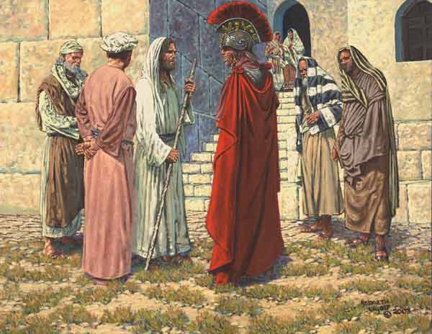
The Trifold Character
Luke 7:1-10 & Matthew 8:5-13
Notes:
A threefold character is not unusual it is just that we don’t often look at ourselves and others in such a way.

Slide 3
The Trifold Character
His first fold:
The first assessment of his character was made by the Jews who knew him.
Luke 7:3-5 – He had a reputation among the Jews and they spoke on his behalf

Slide 4
The Trifold Character
Christians should have this type of character.
Rom. 12:18 – as much as possible live peaceably with all
1 Tim. 3:7 – have a good report from those outside
1 Peter 2:12-16 – honorable among the Gentiles
Rom. 2:24 – Does your character cause others to speak ill of God, His church, or His people

Slide 5
The Trifold Character
His second fold:
The second assessment is made by the centurion himself.
The character of the centurion shines forth as he cared for his servants.
Luke 7:2 – servant was dear to him
Matt. 8:6 – paralyzed, dreadfully tormented
Col. 4:1 – masters be just and fair
Eph. 6:9 – masters do not be intimidating
Luke 10:25-37 – the parable of the merciful Samaritan

Slide 6
The Trifold Character
Luke 7:6-7 – the centurion did not consider himself worthy of Christ’s presence in his house
This took on a two fold nature itself; first he did not think Jesus should come into his house and second he did not think himself worthy to even approach Jesus.

Slide 7
The Trifold Character
Matt. 8:8 – “I am not worthy…”
His humility is an example for us.
1 Peter 5:5-6 – be clothed with humility
James 4:6 – grace to the humble
Prov. 22:4 – humility leads to life
Luke 18:9-14 – “everyone who humbles himself will be exalted…”
Notes:
remember this example of the Pharisee and the tax collector

Slide 8
The Trifold Character
His third fold:
The third assessment is made by Jesus.
Luke 7:9, Matt. 8:10 – when Jesus heard he marveled at his belief
Mark 6:6 – Jesus marveled at their unbelief
Jesus marveled because of the statement made by the centurion concerning Jesus power and authority.

Slide 9
The Trifold Character
Luke 7:8, Matt. 8:9 – “I also am a man placed under authority…”
This centurion was able to recognize Jesus had authority and power.
Luke 7:7, Matt. 8:8 – “But say the word and my servant will be healed.”
This is the type of faith that Jesus is looking for. He recognized Jesus’ power and authority without questioning.

Slide 10
The Trifold Character
Matt. 5:20 – Jesus taught their righteousness must exceed that of the Pharisees
Matt. 23 – vs.3 – “do not do according to their works”
The entire chapter is an indictment on the faithlessness of the scribes and Pharisees as they sought to establish their own righteousness.
Notes:
Remember the parable of the Pharisee and the tax collector

Slide 11
The Trifold Character
Jesus said, “I have not found such great faith, not even in Israel.”
Luke 18:8 – Will He really find faith when He returns?
Luke 7:7-8 – the unquestioning recognition of the centurion
Gen. 22:1-19 – the obedient faith of Abraham
Acts 10:17-24 – the faith that sets aside doubt

Slide 12
The Trifold Character
Our trifold character must be similar.
1. By those outside
2. Humble recognition of God by obedience
3. Ultimately by Jesus –
“well done good and faithful servant”

